Slide 1


Lesson 2
Who is who
STARTING UP

Slide 2
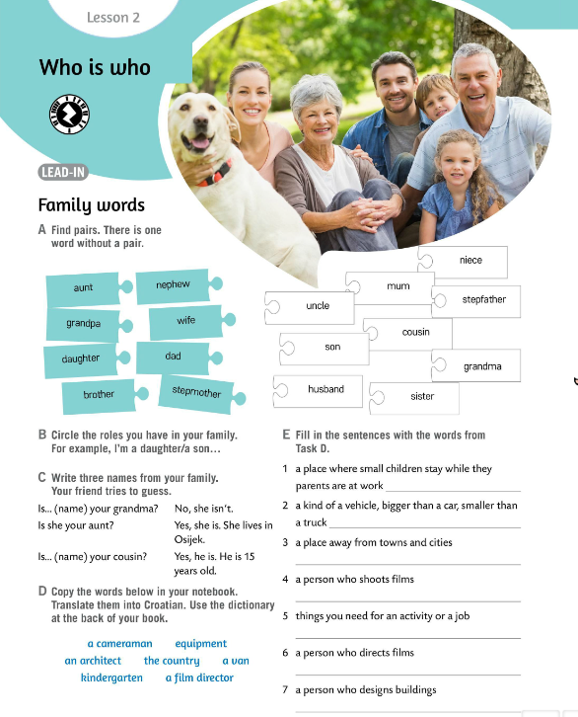
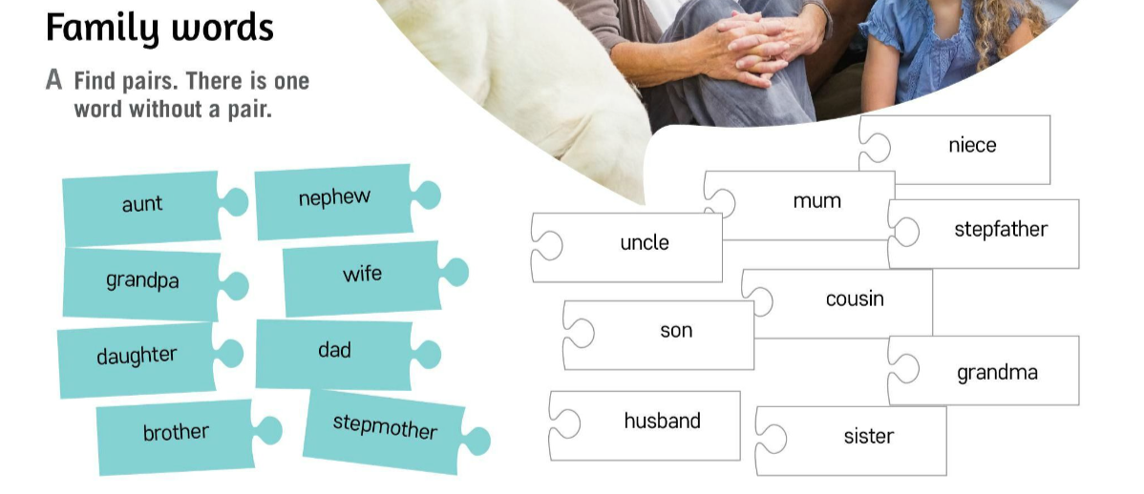
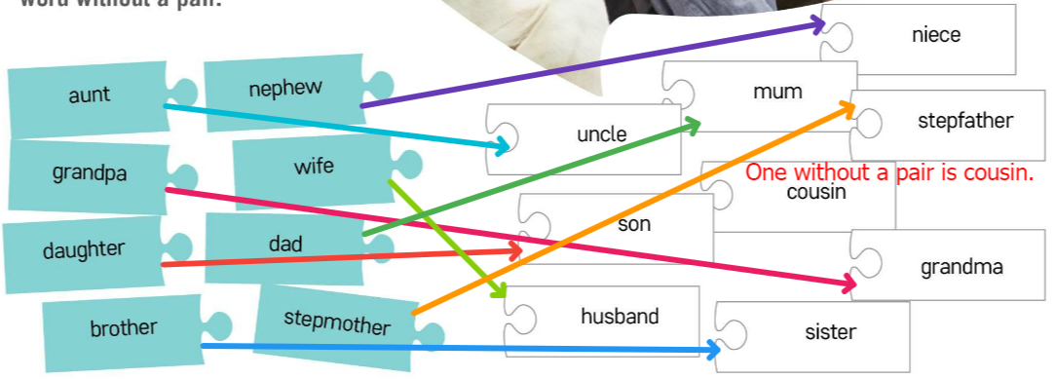
Who is who? Find pairs in task A. Be careful, there is one word without a pair.
Let’s revise!
aunt – tetka, ujna, strina
grandpa – djed
daughter – kćer
brother – brat
nephew – nećak
wife – žena
dad - tata
stepmother – pomajka, maćeha
uncle – ujak, stric
son – sin
husband – muž
mum – mama
cousin – bratić, sestrična, rođak
sister – sestra
niece – nećakinja
stepfather – očuh, poočim
grandma – baka
Check.

Slide 3
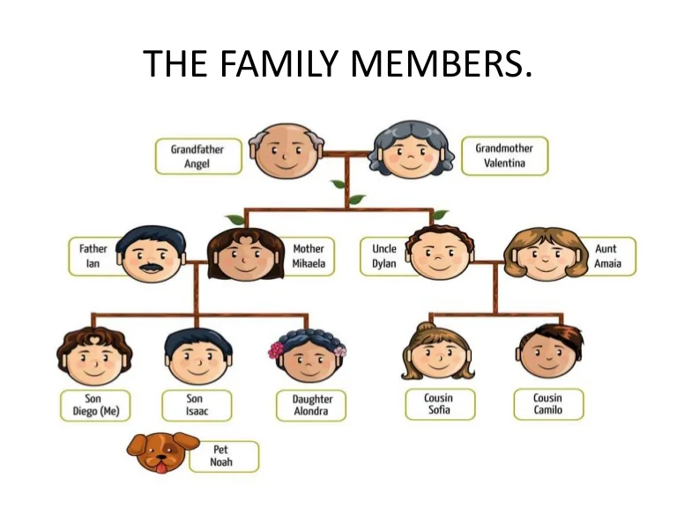
Now let’s play a game and revise family members!
https://wordwall.net/play/510/593/427

Slide 4

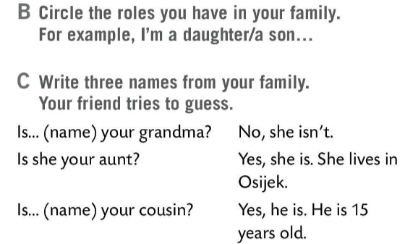

Circle the roles you have in your family. For example, I’m a daughter/ a son….
Write three names from your family. Then look at the questions in task C and play with your friend. Try to guess what family member hides behind the name.

Slide 5
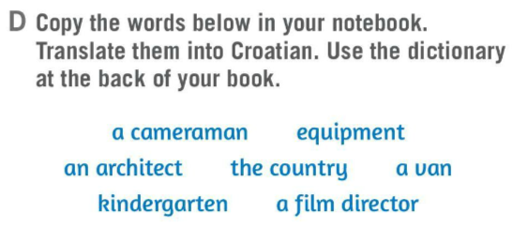
Read the words in task D.
Copy the words in your notebook and translate them into Croatian.
Use the dictionary at the back of your book.
Let’s check.
a cameraman – filmski snimatelj
an architect – arhitekt
kindergarten – vrtić
equipment – oprema
the country – selo (država)
a van – kombi
a film director – redatelj

Slide 6
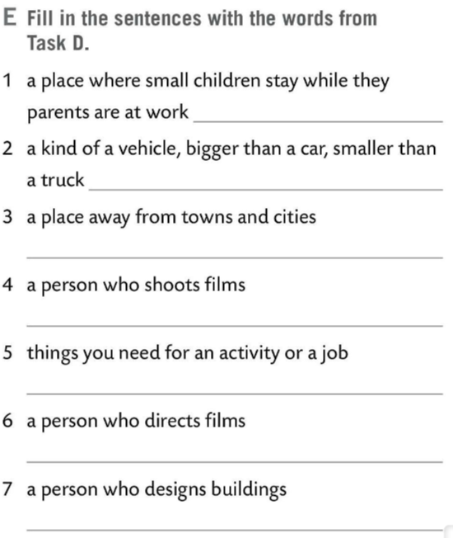
Fill in the sentences in task E with the words from task D.
Let’s check.
kindergarten
a van
the country
a cameraman
equipment
a film director
an architect

Slide 7
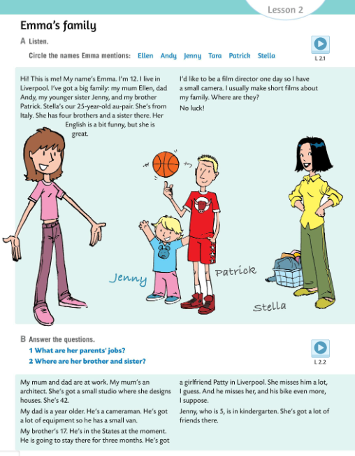

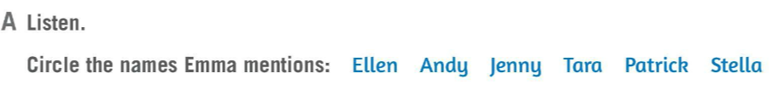
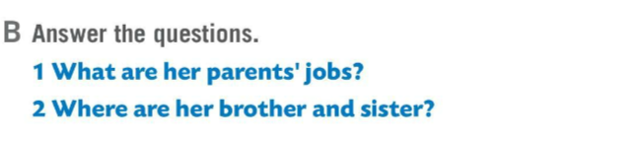
Listen to the recording.
Listen again. Do task A. Circle the names Emma mentions.
Check.
Listen to the recording for the third time and answer the questions in task B.
Check.
1 Her mum is an architect and her dad is a cameraman.
2 Her brother is in the USA and her sister Jenny is in kindergarten.

Slide 8
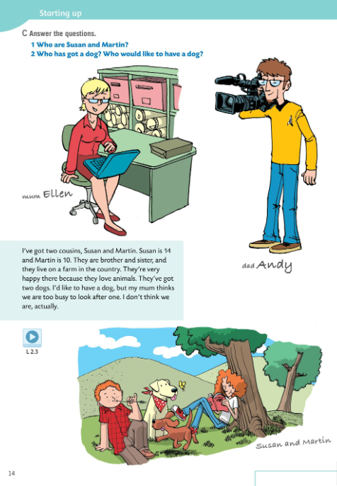
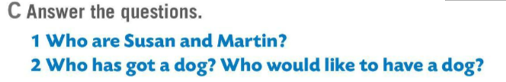
Listen to the recording.
Listen again and answer the questions in task C.
Check.
1 Susan and Martin are Emma’s cousins.
2 Susan and Martin have got two dogs. Emma would like to have a dog.
Read the text aloud.

Slide 9
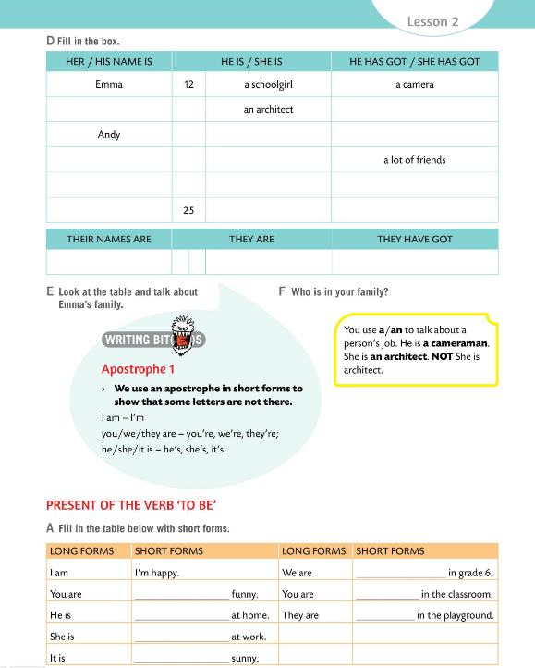
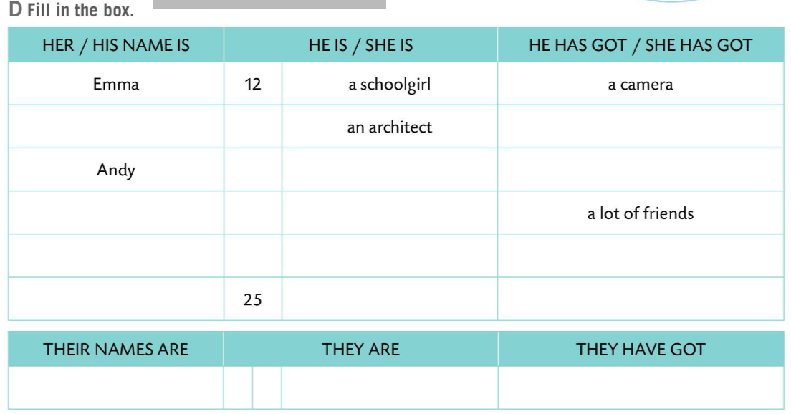

Look at the task D.
Fill in the box.
Let’s check.
Ellen
42
a small studio
43
a cameraman
a van, a lot of equipment
Jenny
5
in kindergarten
Patrick
17
in the States
a girlfriend in Liverpool, a bike
Stella
au-pair from Italy
four brothers and a sister in Italy
Talk about Emma’s family.
Susan and Martin
14
brother and sister
two dogs
10
Present your family. Who is in your family?

Slide 10
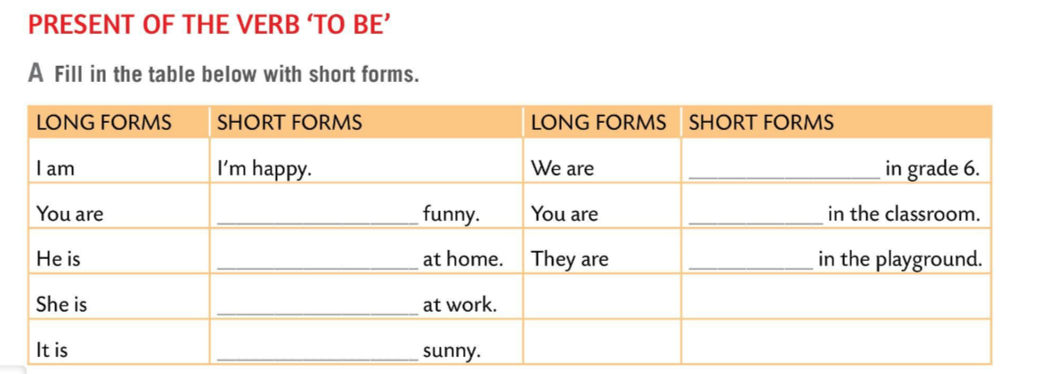
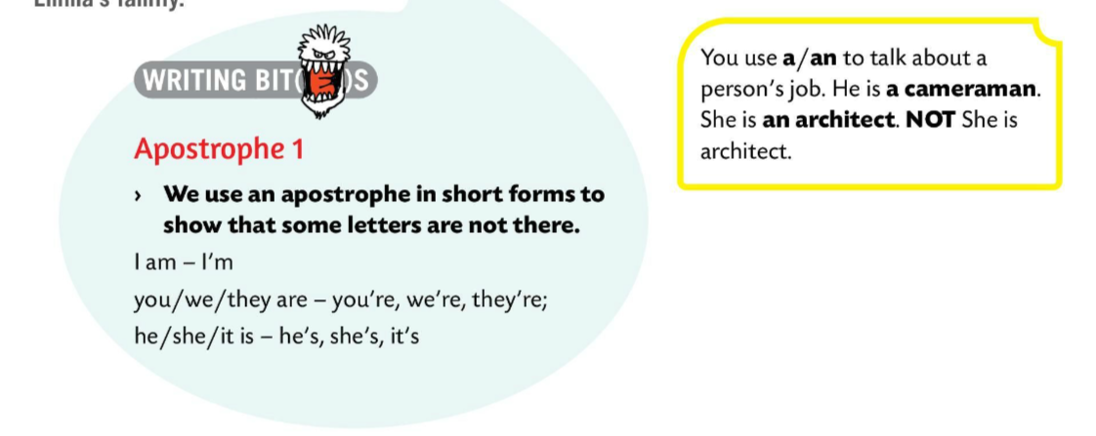
WRITING BITES.
We use an apostrophe in short forms to show that some letters are not there./ Izostavnik ili apostrof ‘ koristimo u kratkim oblicima te njime označavamo da je izostavljeno jedno slovo ili skup slova.
e.g. I am → I’m (Letter ‘a’ is not there. Izostavili smo slovo a.)
You use a/an to talk about a person’s job. Članove a/an koristimo kada govorimo o zanimanjima.
e.g. He is a cameraman. She is an arcitect. NOT He is cameraman. She is architect.
We’re
You’re
You’re
He’s
They’re
She’s
It’s
Fill in the table in Task A with short forms of the verb ‘TO BE’.
Check.

Slide 11
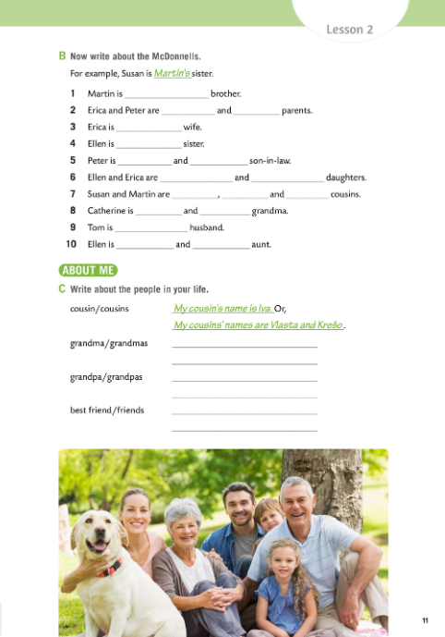

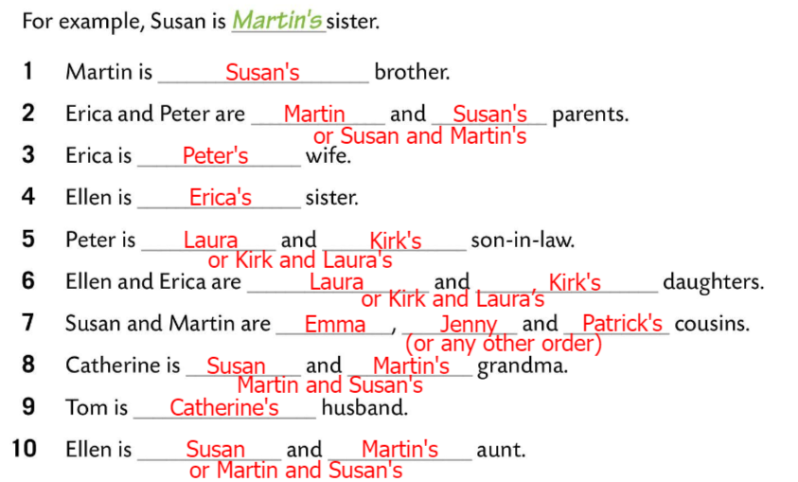
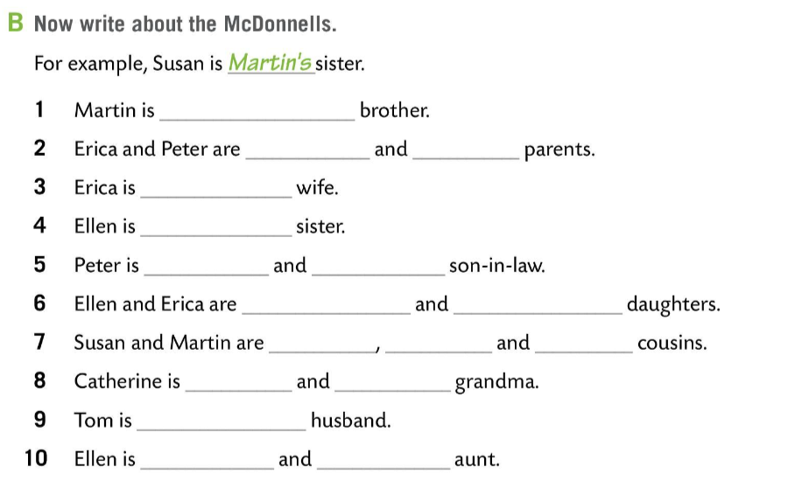
Workbook page 11.
Write sentences about McDonnells.
Check.

Slide 12
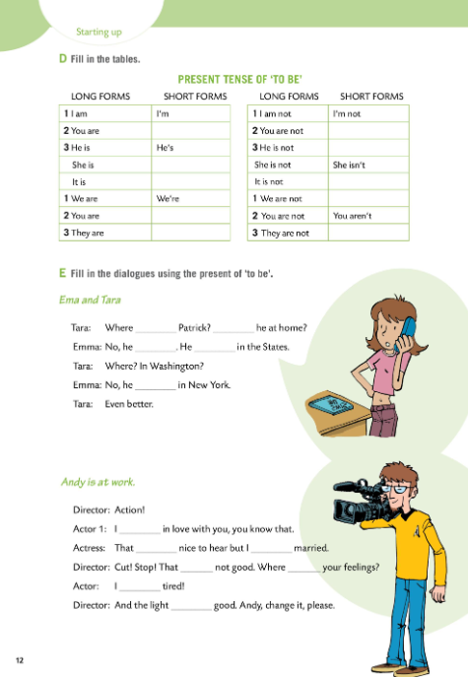
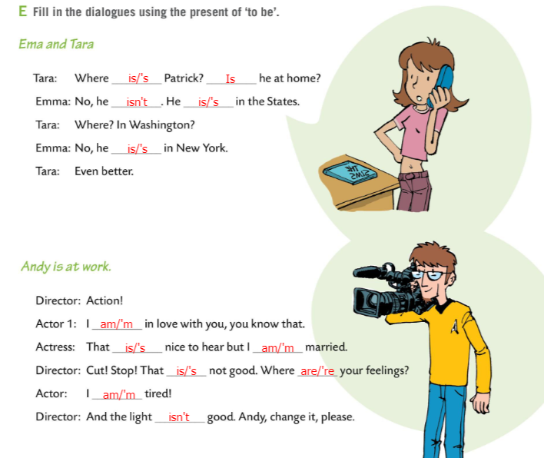
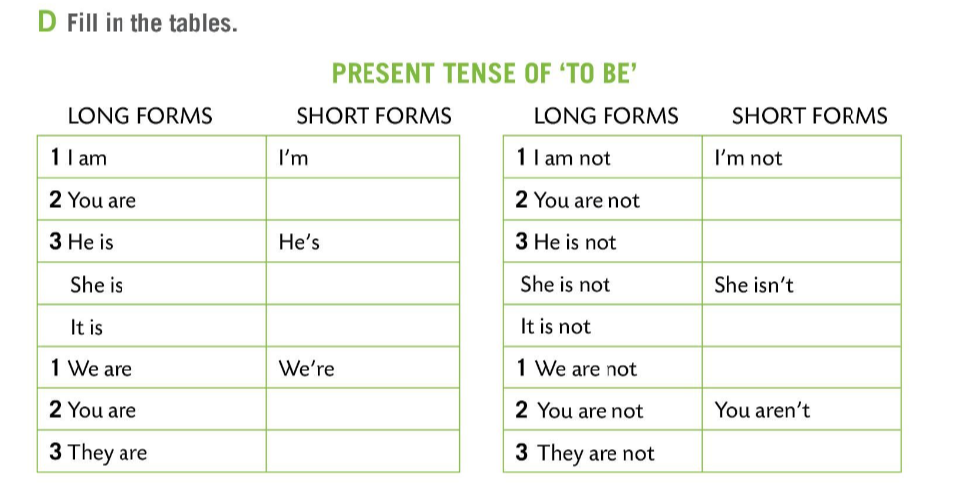
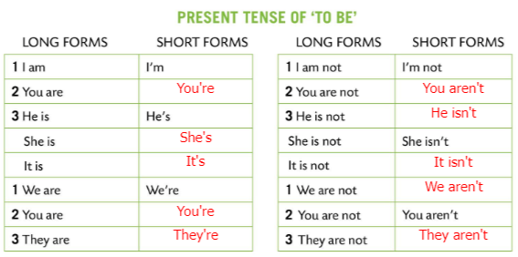
Workbook page 12 and 13.
Fill in the table in Task D.
Check.
Fill in the dialogues in Task E on pages 12 and 13 using long or short forms of ‘to be’.
Check.

Slide 13
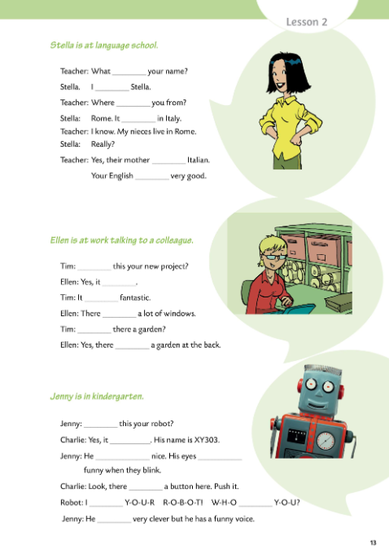
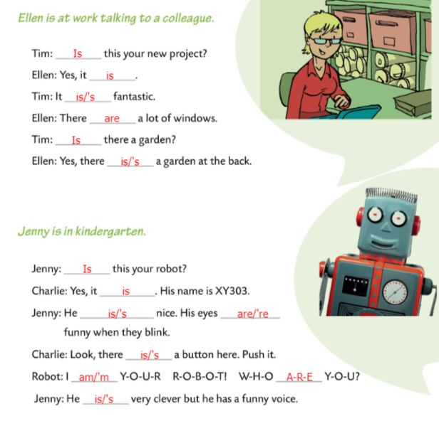
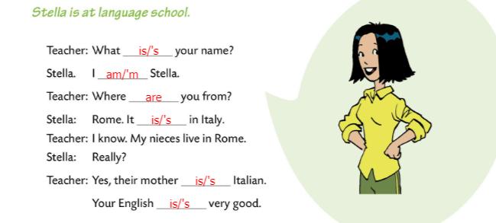
Workbook page 12 and 13.
Fill in the dialogues in Task E on pages 12 and 13 using long or short forms of ‘to be’.
Check.

Slide 14
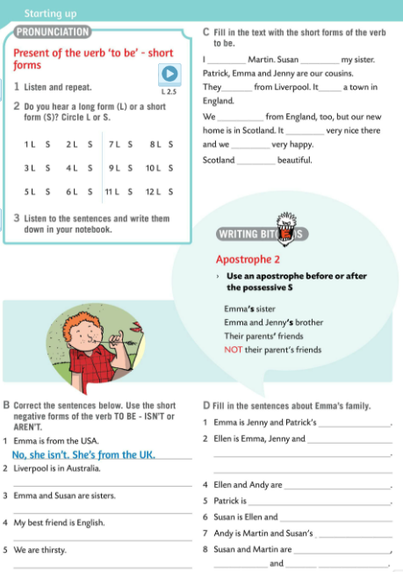
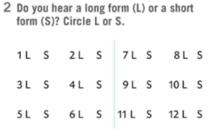
Listen and repeat after the recording .
Do you hear a long form (L) or a short form (S)? Circle L or S.
Listen to the recording once more and do the 2nd task.
Check.
Listen to the sentences and write them down in your notebook.

Slide 15
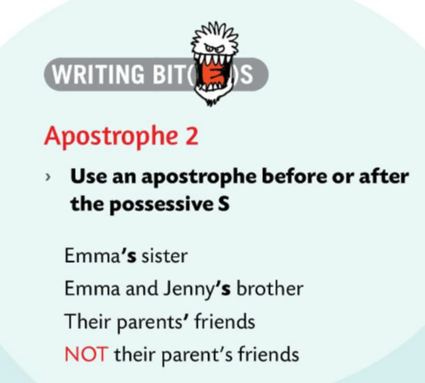
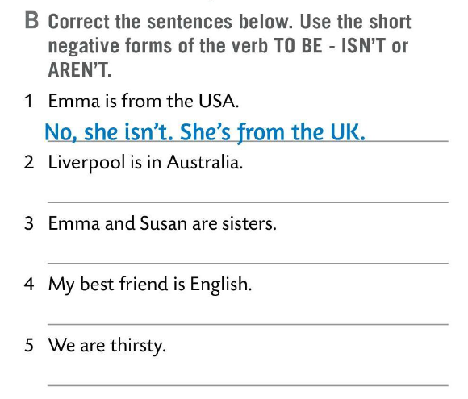

Read and correct the sentences in Task B. Use the short negative forms of the verb TO BE – ISN’T or AREN’T.
Check.
WRITING BITES
Use an apostrophe before or after the possessive S. Izostavnik ili apostrof koristimo ispred ili iza posvojnog oblika.
e.g. Emma’s sister
Their parents’ friends.

Slide 16
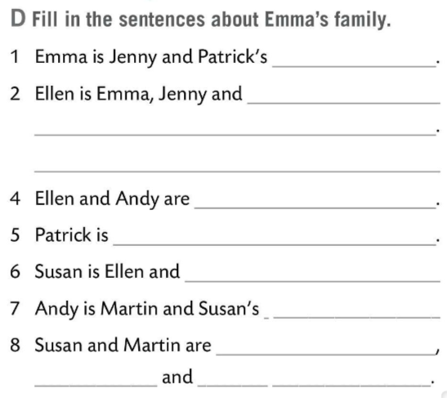
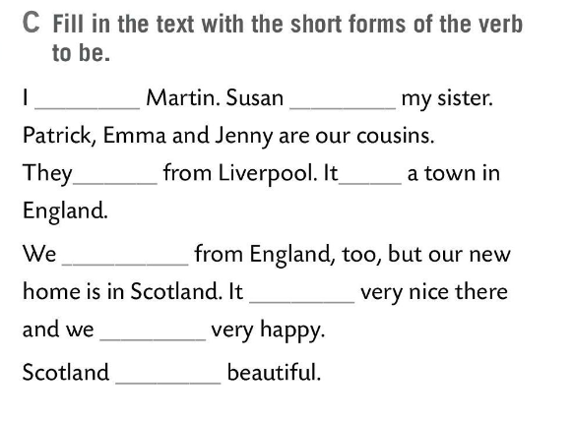
Fill in the text with the short forms of the verb to be.
Check.
‘m
‘s
‘re
‘s
Fill in the sentences about Emma’s family in task D.
‘re
‘s
‘re
Check.
‘s

Slide 17
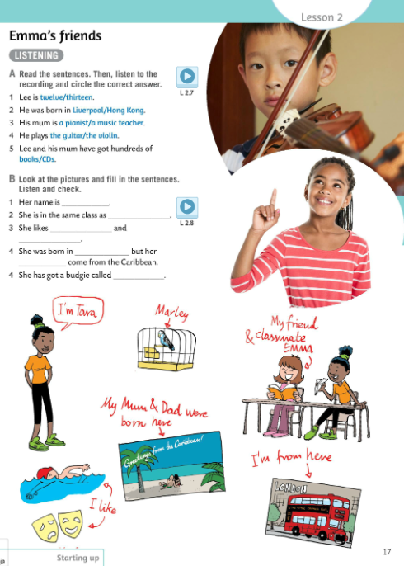
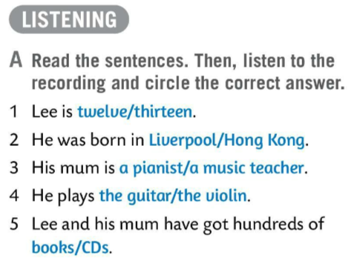
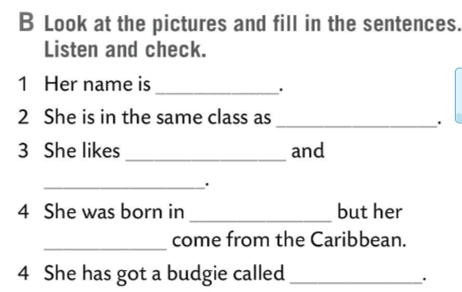
Read the sentences in Task A. Then, listen to the recording and circle the correct answer.
Check.
Tara
Emma
swimming
Look at the pictures and fill in the sentences in Task B. Then listen and check your answers.
Listen and check.
acting
London
parents
Marely

Slide 18
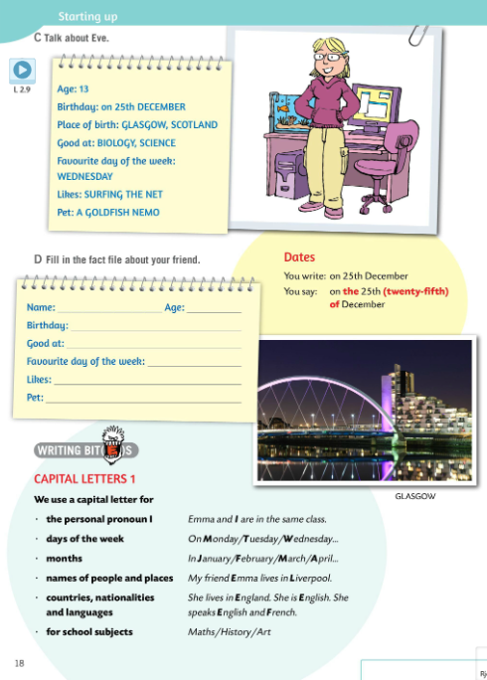
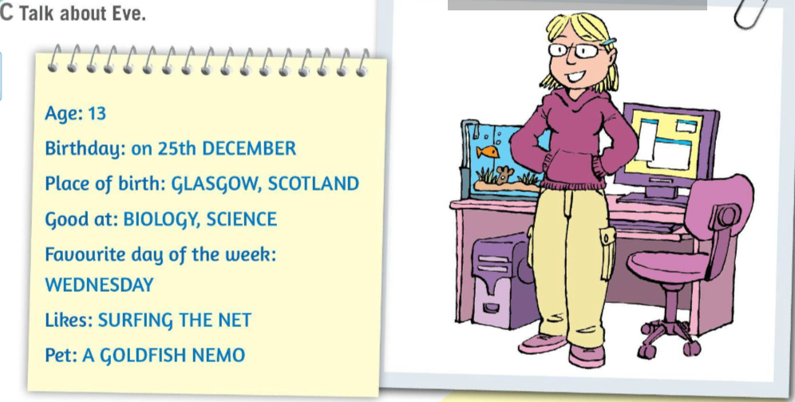
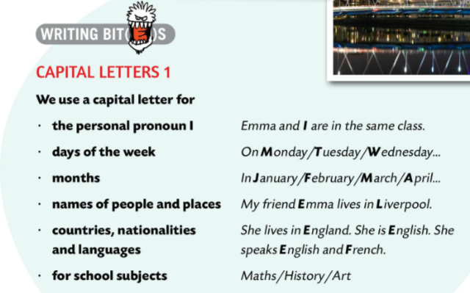
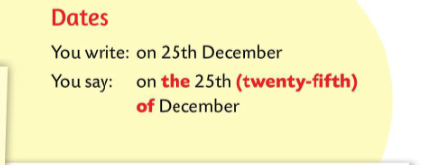
Listen to the recording and talk about Emma’s friend Eve.
Zapamti!
Pišemo: on 25th December.
Govorimo: on the 25th (twenty-fifth) of December
WRITING BITES
Velika početna slova u engleskom jeziku koristimo pri
pisanju:
osobne zamjenice ja – I
dana u tjednu (on Friday)
mjeseci u godini (in July)
nazivima ljudi i mjesta (My cousin Eve lives in Glasgow.)
nazivima zemalja, nacionalnosti i jezika (He lives in Italy. He is Italian. He speaks Italian and Greman.)
nazivima školskih predmeta (Music, Art, PE).

Slide 19
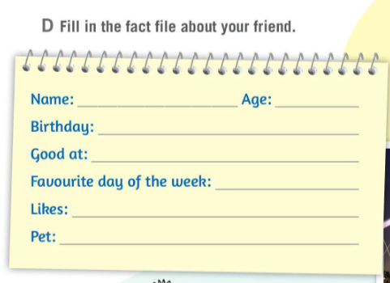
Fill in the fact file about your friend in Task D.

Slide 20
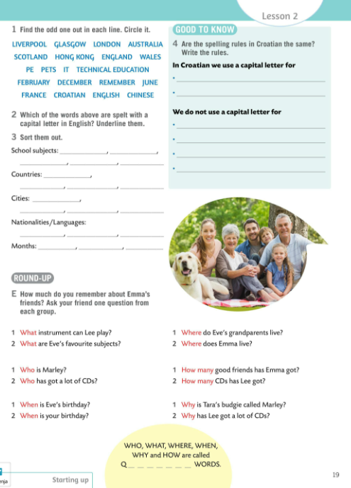
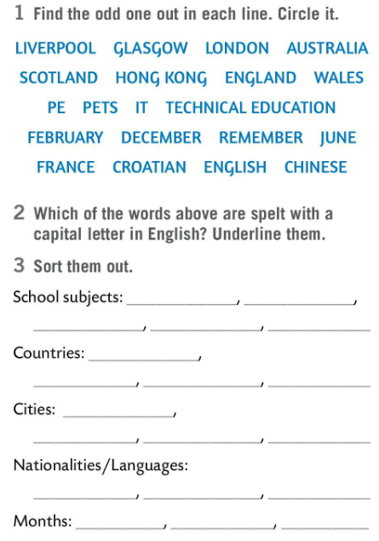
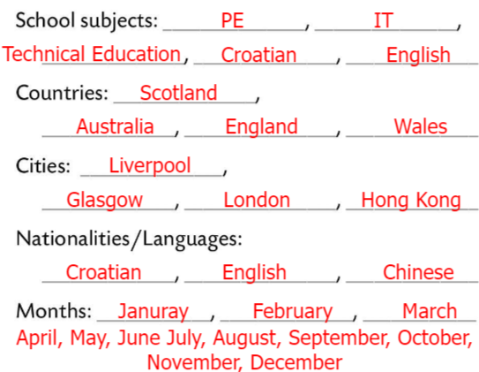

Find the odd one out in Task 1. Circle it.
Check.
Which of the words from the Task 1 are spelt with a capital letter in English? Underline them.
Sort the words from Task 1 and write them down on gaps in Task 3.
Check.

Slide 21
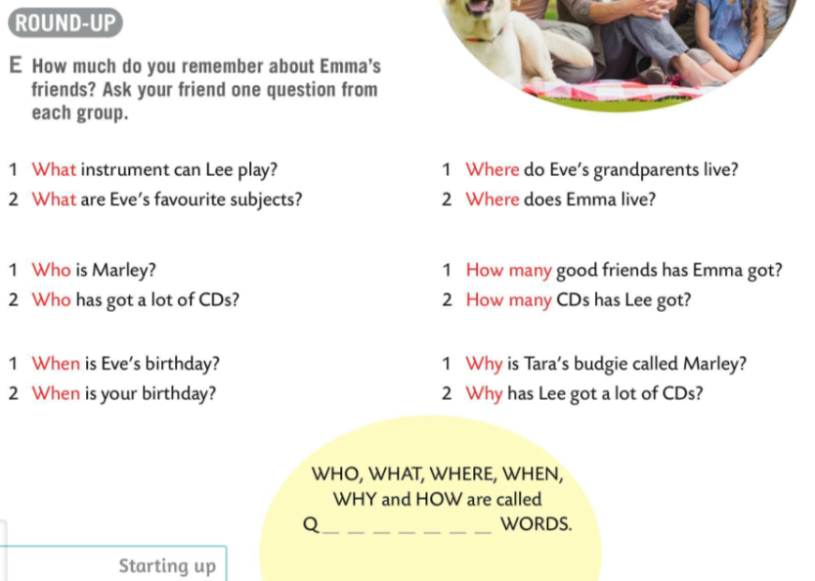
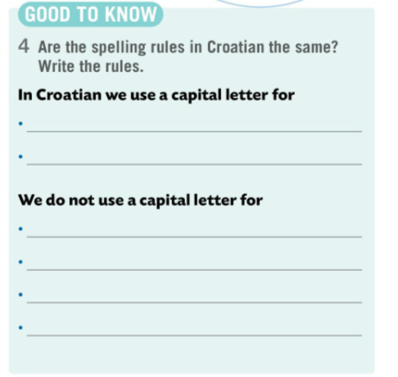

Do Task 4 for homework. Write the rules.
How much do you remember about Emma’s friends? Ask your friend one question from each group.
QUESTION WORDS – UPITNE RIJEČI (U engleskom jeziku se koriste za postavljanje pitanja. U upitnim rečenicama upitna riječ je na prvom mjestu, prije pomoćnog glagola.)

Slide 22
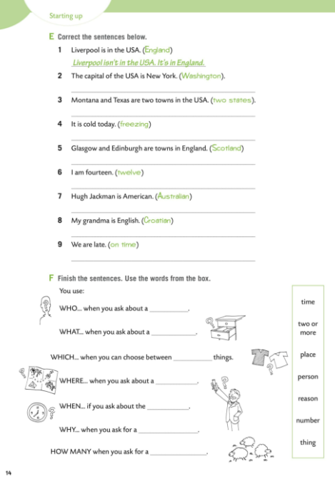
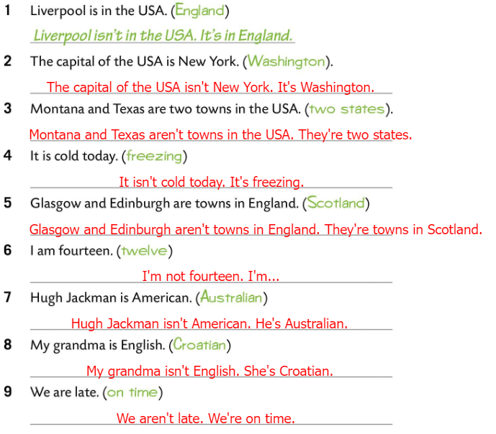
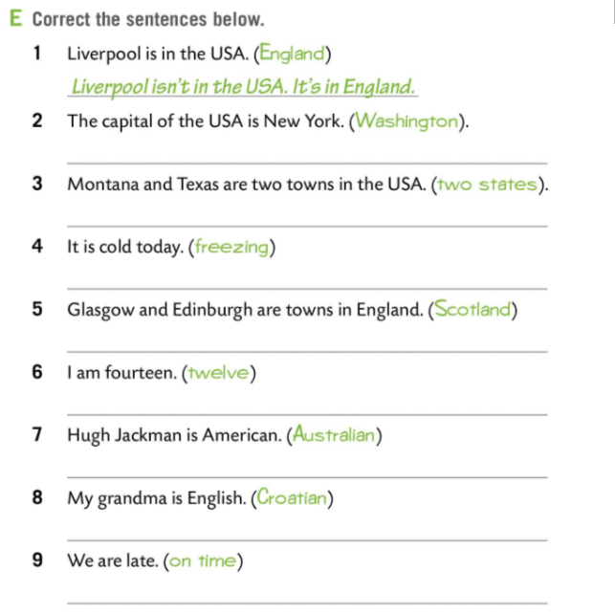
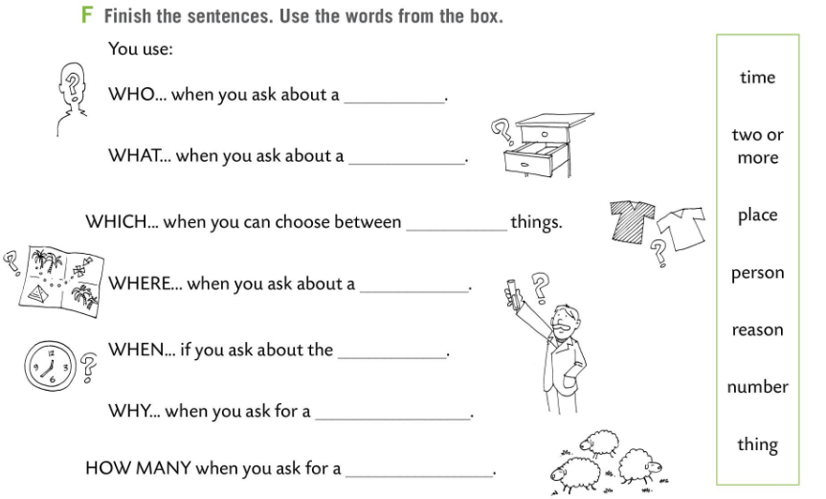
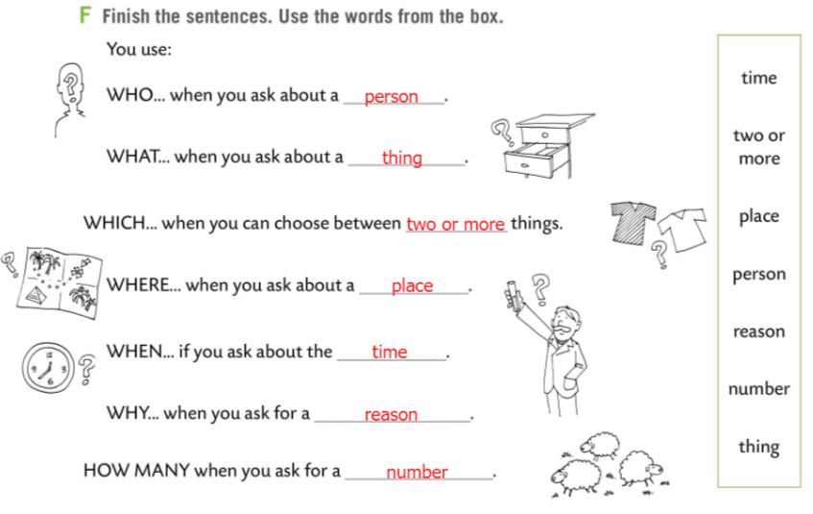
Workbook pages 14 and 15.
Correct the sentences in Task E.
Use the words in bracktes to write correct sentences.
Check.
Look at the pictures and finish the senteces about QUESTION WORDS in task F.
Use words from the box.
Check.

Slide 23





Workbook pages 14 and 15.
Write the correct question word in Task G.
Check.
Fill in the sentences in Task H with the right question word from the box. Use each question word twice.
Check.

